Slide 1
Microsoft Azure – Basic Concepts

Slide 2
Subscription
Account
Account
Logical Container
Identity
Contains the various resources you provision in the cloud (VMs, DBs, networks etc.)
An identity with access to resources in the subscription (i.e. You)
Can be attached to a
lot of accounts
Can be attached to a
lot of subscription

Slide 3
Azure CLI
Cloud Shell
PowerShell
Run Azure commands from the command line
Run Azure commands from the PowerShell or Bash
Almost identical capabilities
Different syntax
CLI can be run from scripting languages (Python etc.)
Use whatever you want

Slide 4

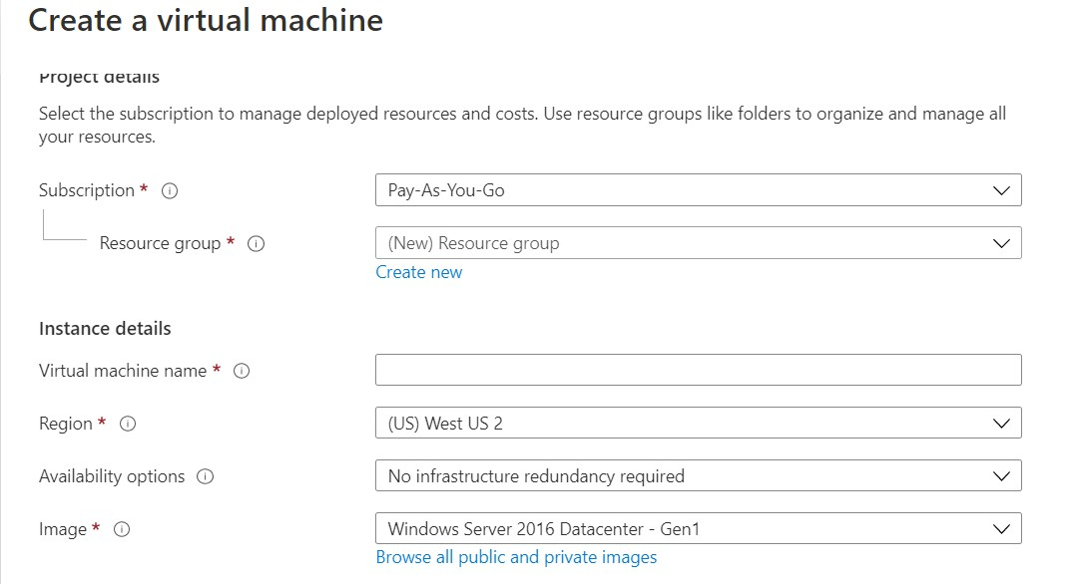
Selecting Regions
Almost every resource in Azure should be placed in a Region

Slide 5
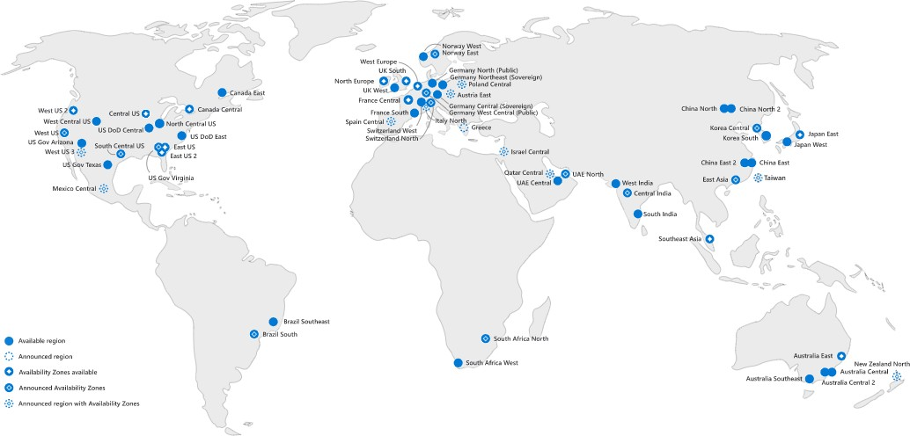
How to Select Region?
Geographical proximity to system’s audience

Slide 6
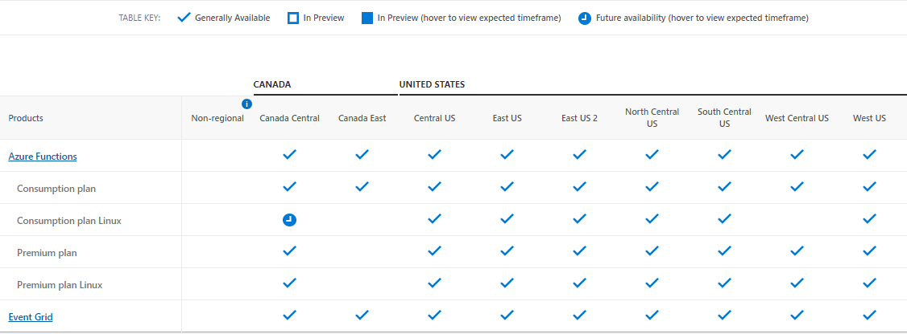
How to Select Region?
Services’ availability
Source: https://azure.microsoft.com/en-us/global-infrastructure/services/

Slide 7
How to Select Region?
Availability Zones

Slide 8
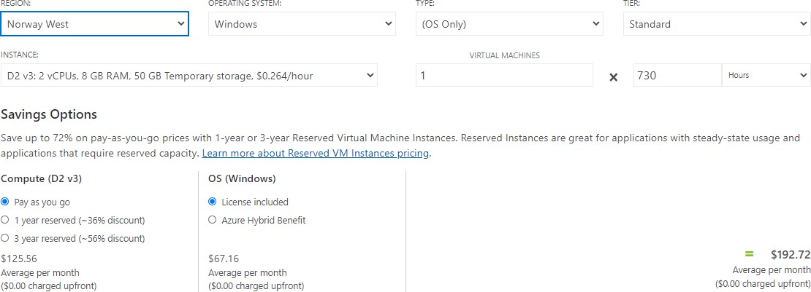
How to Select Region?
Pricing

Slide 9
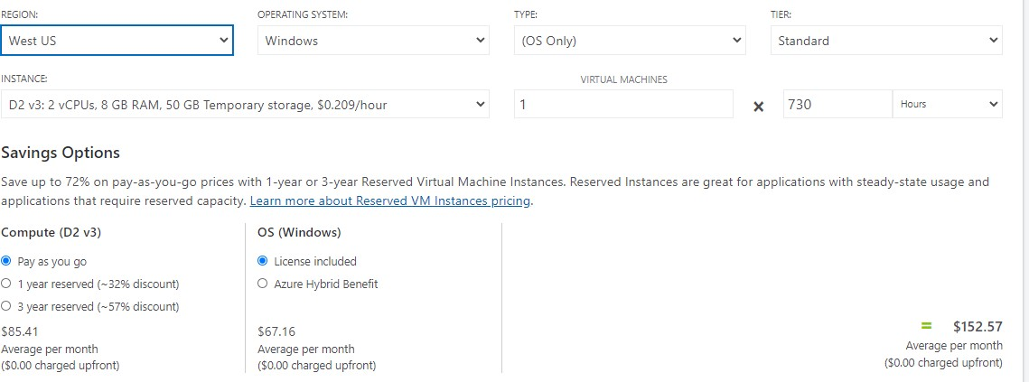
How to Select Region?
Pricing

Slide 10
Resource Groups
A logic container for resources
Used for grouping resources by a logic boundary
Free
Examples:
Development / Test / Production resources
Team A resources

Slide 11

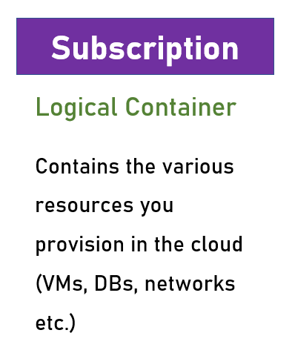
Resource Groups vs Subscriptions

Slide 12
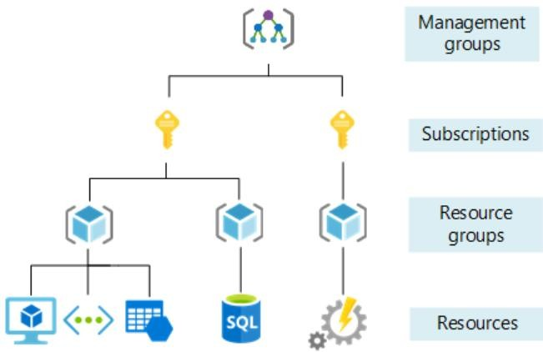
Resource Groups vs Subscriptions
- Manages Subscriptions
Associates accounts
Cost center
Logical Resources
Container
Source: https://docs.microsoft.com/en-us/azure/cloud-adoption-framework/ready/azure-setup- guide/organize-resources?tabs=AzureManagementGroupsAndHierarchy

Slide 13
Resource Groups Naming Conventions
It’s best practice to have an “rg” or “RG” as part of the resource
group name
Could be prefix or suffix
RG-Project-Dev Finance-Resources-rg

Slide 14
Resource Groups
Almost every resource in Azure is placed in a Resource Group

Slide 15
Storage Account
Used to store almost anything in Azure
Used transparently by various services
For example:
Database backups
VM Disks
Diagnostics data

Slide 16
Storage Account
Used also for explicit data storage
We’ll discuss it later…
Quite cheap

Slide 17
SLA
Service Level Agreement
The uptime % of a cloud service
SLA (%) | Yearly Downtime Allowed
95 | 18d 6h 17m 27s
99 | 3d 15h 39m 29s
99.9 | 8h 45m 56s
99.99 | 52m 35s
SLA & Uptime calculator: How much downtime corresponds to 99.99 % uptime

Slide 18

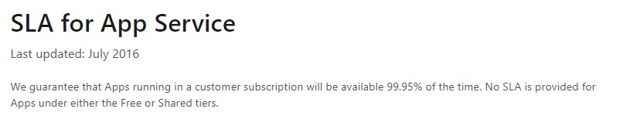
SLA
ALWAYS check the SLA of the service used

Slide 19

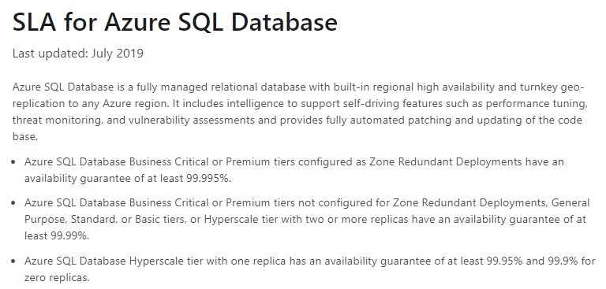
SLA
ALWAYS check the SLA of the service used

Slide 20
SLA Calculation
To get the actual system SLA, multiply the SLAs of the participating
services
App Service SLA = 99.95% Azure SQL SLA = 99.99%
Actual SLA = 99.95 X 99.99 = 99.94% = 5h 15m 34s annual downtime

Slide 21
Cost
Almost everything in the cloud costs money
Few pricing models:
Per resource (ie. VM)
Per consumption (ie. Function Apps)
Reservations

Slide 22
Cost
ALWAYS check resource’s cost before provisioning
Check for more cost-effective alternatives
Look for reservations when available and relevant

Slide 23
Azure Calculator
https://azure.microsoft.com/en-us/pricing/calculator/

